Slide 1


TF Product Line
Please hold all questions until the end of the presentation.

Slide 2
We are about to view some disturbing data.
Buckle up..

Slide 3
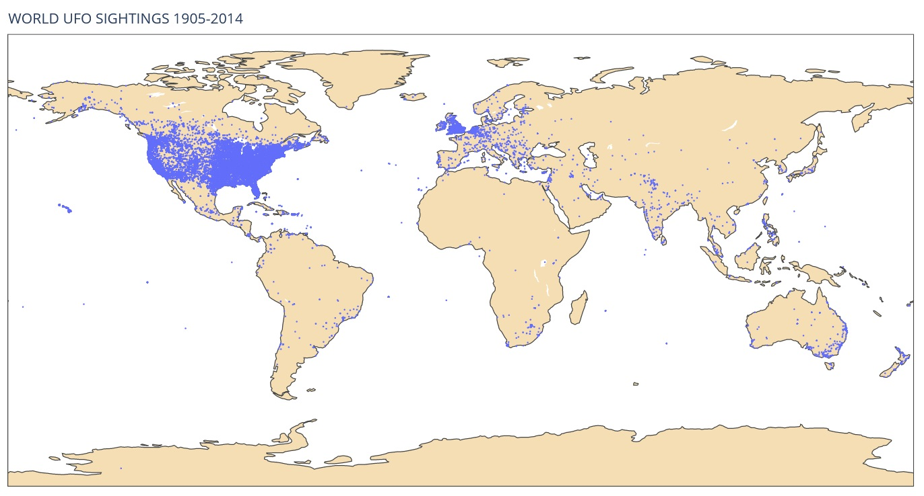
We are looking at 80,000 UFO sightings from 1905-2014

Slide 4
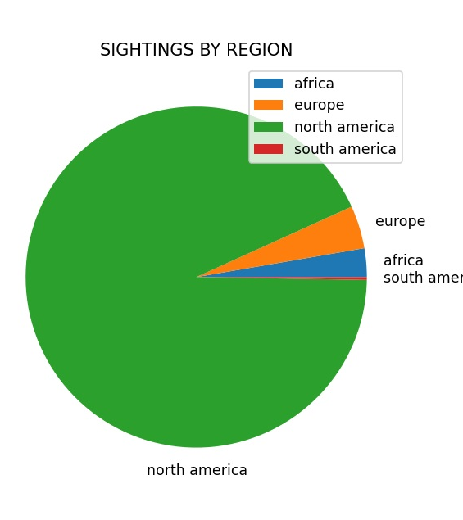
The vast majority of the sightings are in the USA/North American Region

Slide 5

They are here and they are targeting
AMERICANS!

Slide 6
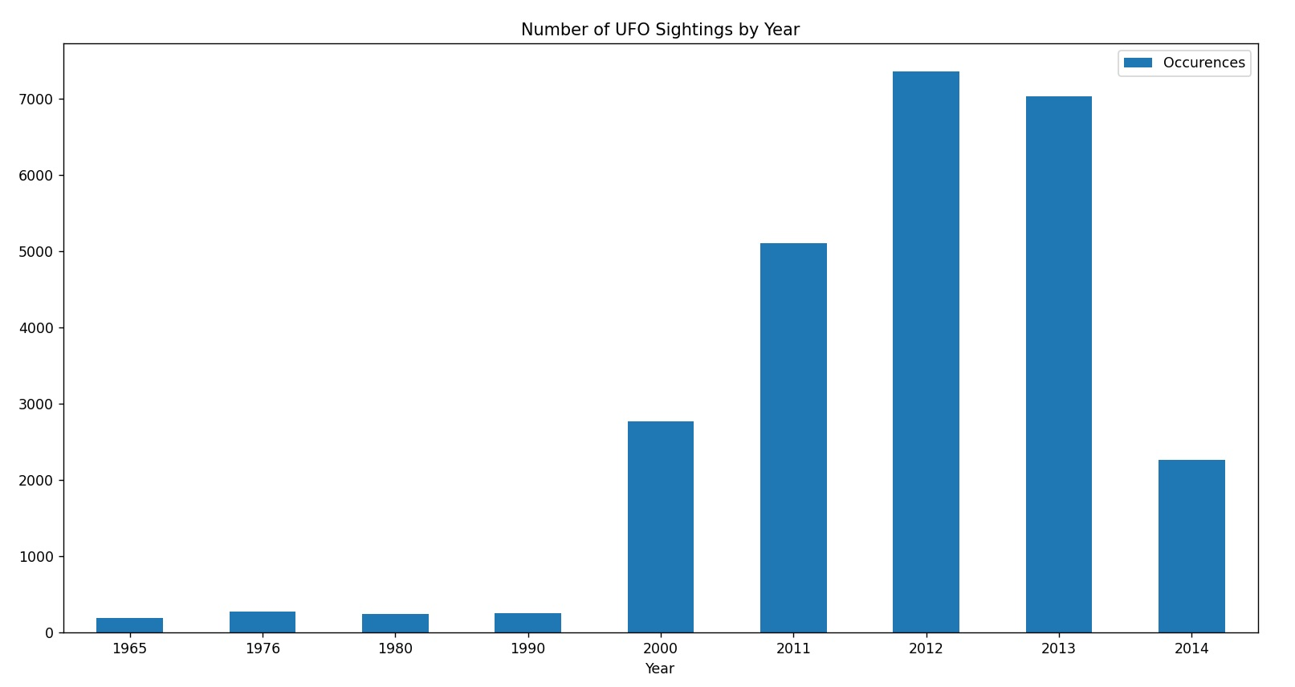
Between 2000-2012 they ramped up operations…
By why?

Slide 7
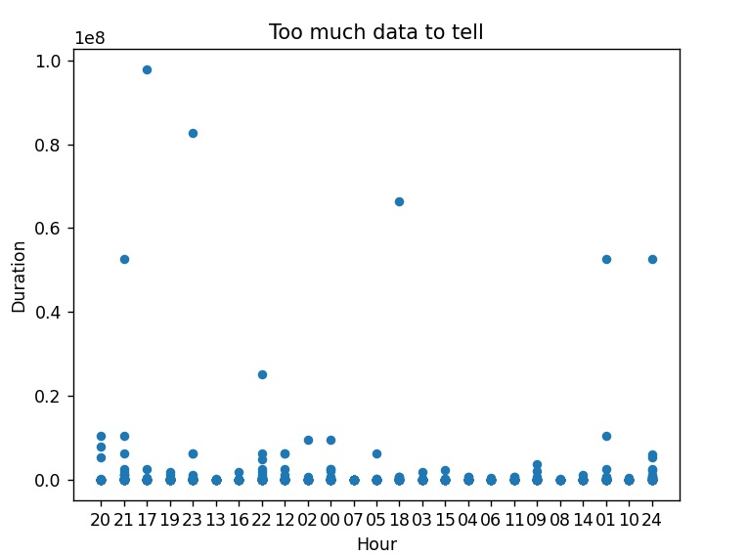
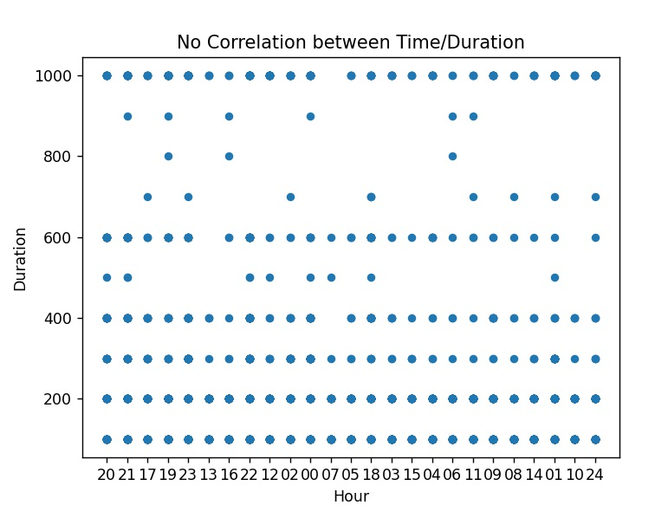
Each sighting recorded time of day and duration.
We found NO correlation
It means they are smart.

Slide 8
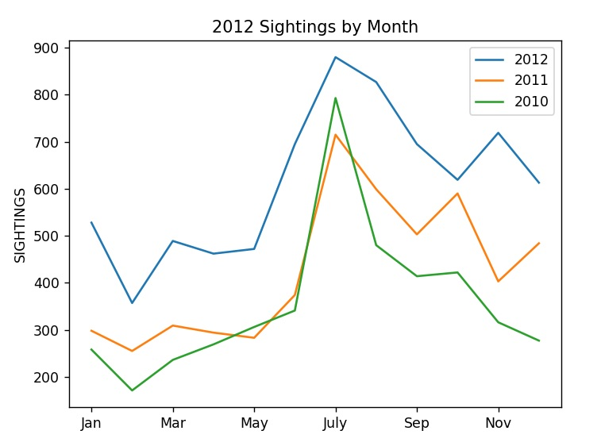
Just look how they target JULY for the majority of their visits.

Slide 9
What are we to do?...

Slide 10

TF Enterprises has the answer.
Our tin foil hat product line will keep you protected... From them.

Slide 11
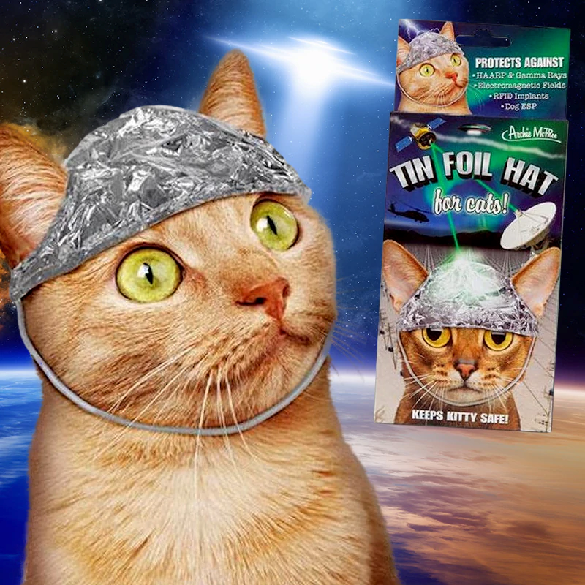
Our products expand to household animals.
Because pets are FAMILY. You want to protect your family.
Invest in TF Products TODAY!

Slide 12
Credits:
Kaggle.com for csv data.
UFO Sightings around the world
80,000+ documented close encounters from the past 70 years
by: Cam Nugent

